Slide 1
MACHINE LEARNING
PROJECT WORK

Slide 2
TABLE OF CONTENT
Id | Table of Content | Location
1 | Data Files | E-Learning
2 | Project files and python notebook | GitHub Repository
3 | Detailed Project Report | GitHub Repository
4 | Detailed Documentation with Readme file | GitHub Repository
5 | Other Files: Embeddings, Images | GitHub Repository
6 | Dataset description | Page 4
7 | Embedding Models | Page 5
8 | Classification Algorithms | Page 7
9 | Algorithms Comparison | Page 23
10 | Summary | Page 24
11 | Sample Notebook (Basic Implementation) | GitHub Repository

Slide 3
PROJECT FILES, REPORT AND DOCUMENTATION
GITHUB LINK: https://github.com/Neelansh01/ML-Project-Work
In the project repository:
Project files with classes implemented for all the Classifier and Pretrained models.
Project Report.
Documentation (steps/sequence to go through the project files and notebooks and the result files).
Dataset Analysis.
Visualizations.
Complete comparison of different classifiers across various derived embeddings.
Critical Findings.
Conclusions

Slide 4
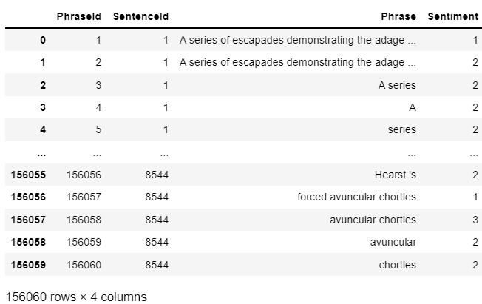
DATASET INTRODUCTION
Features: {PhraseId, SentenceId, Phrase, Sentiment}
Rows: 156060
Columns: 4
Rows utilized: 10000
(for the sake of enabling computation for all the
models like GBDT which take a lot of time.)
Output Classes: 5

Slide 5
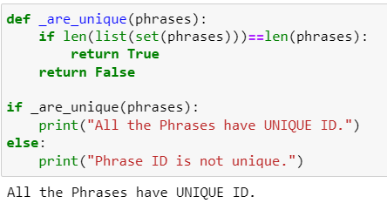
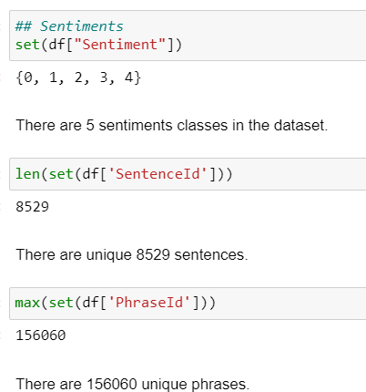
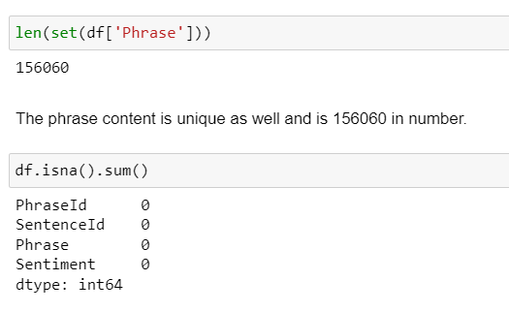
DATASET INTRODUCTION

Slide 6
EMBEDDING MODELS
Embedding models are used to convert the phrases to corresponding mathematical representation.
The pretrained models which find the embeddings use different algorithms/structure of Neural Network to map input text to the output embeddings.
The models used in this project are:
BERT: https://huggingface.co/sentence-transformers/bert-base-nli-mean-tokens
SBERT: https://huggingface.co/sentence-transformers/all-MiniLM-L6-v2
MPNET: https://huggingface.co/sentence-transformers/all-mpnet-base-v2
For the comparison/content in this presentation, we have used the BERT model. Detailed comparison across various models is present in the “Comparison” folder of the repo.

Slide 7
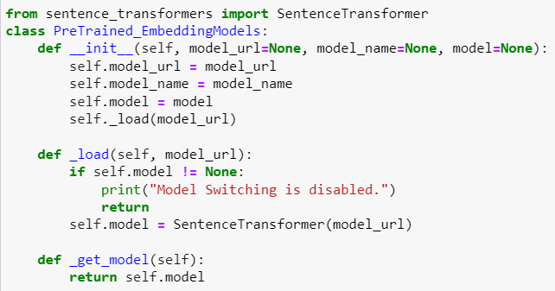
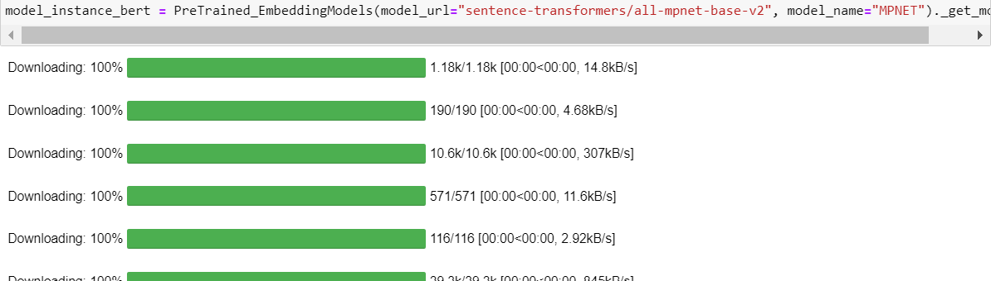
EMBEDDING MODELS
Class for Pretrained models
Class for Pretrained models

Slide 8
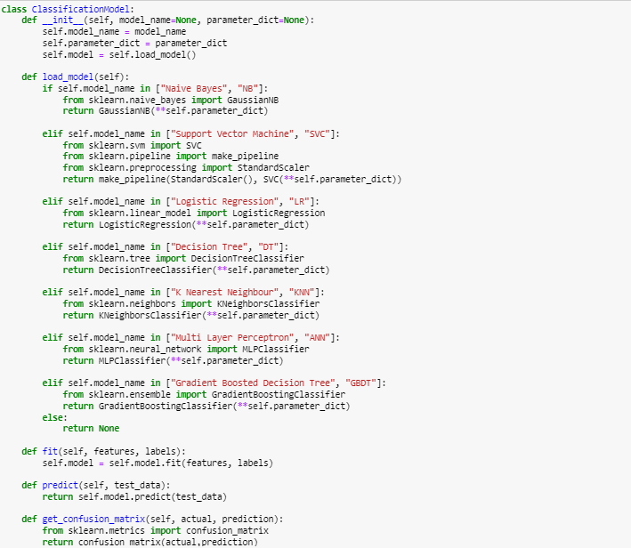
CLASSIFICATION MODELS CLASS

Slide 9
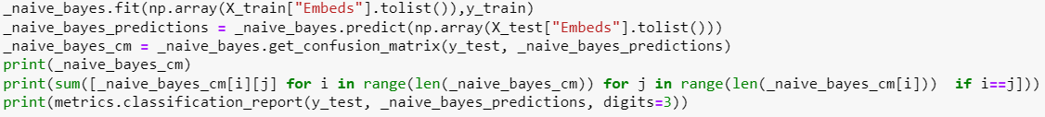
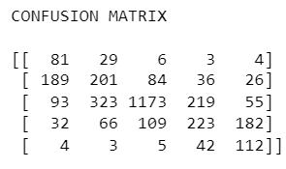
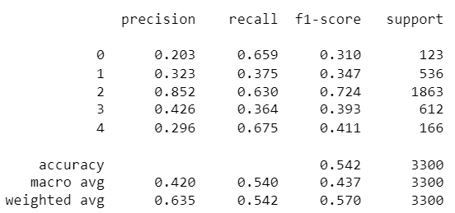
CLASSIFICATION ALGORITHMS: NAÏVE BAYES

Slide 10
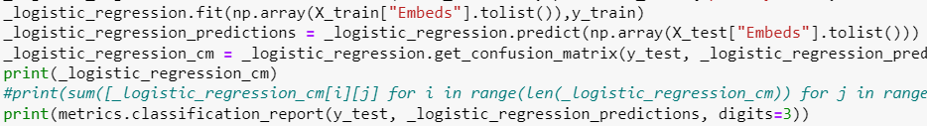
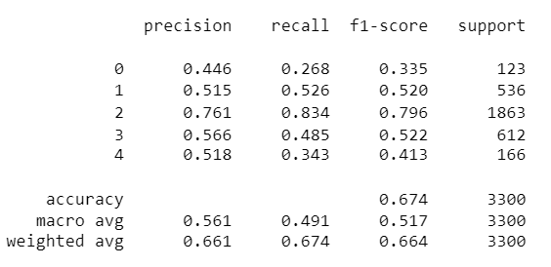
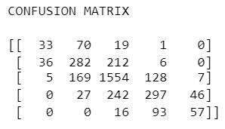
CLASSIFICATION ALGORITHMS: LOGISTIC REGRESSION

Slide 11
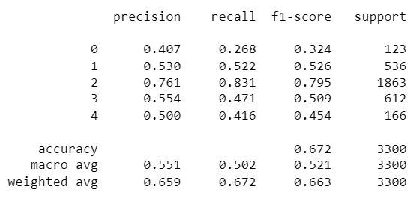
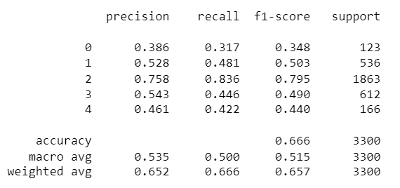

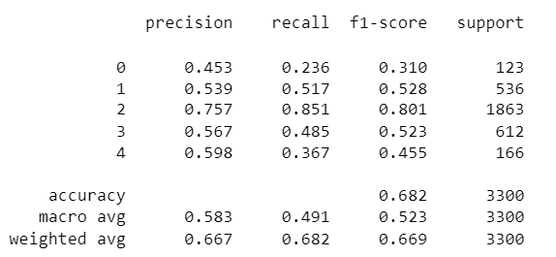
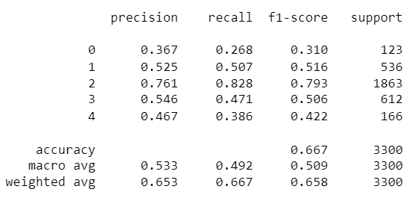
LOGISTIC REGRESSION: HYPERPARAMETERS

Slide 12
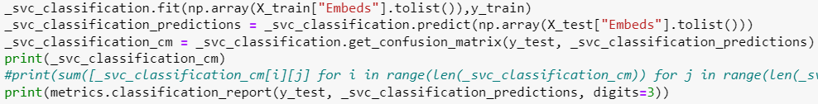
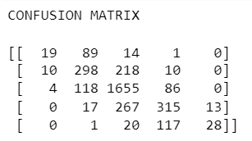
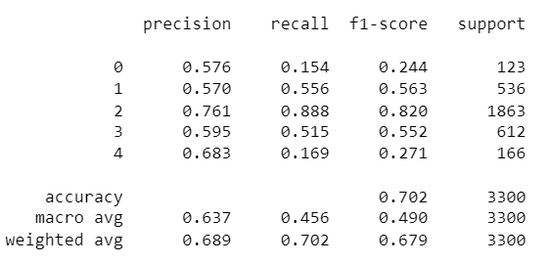
CLASSIFICATION ALGORITHMS: SUPPORT VECTOR CLASSIFIER

Slide 13
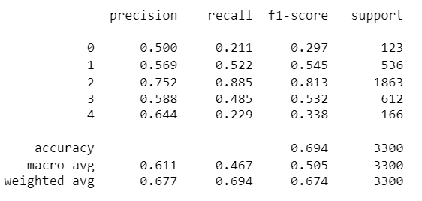
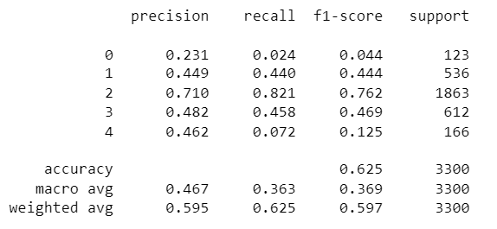
SVC: HYPERPARAMETERS

Slide 14
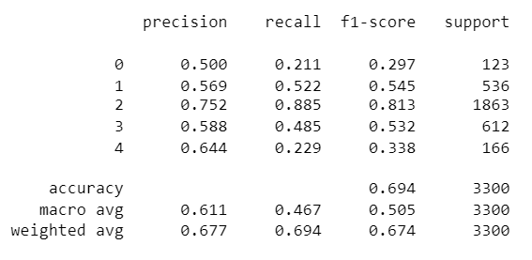
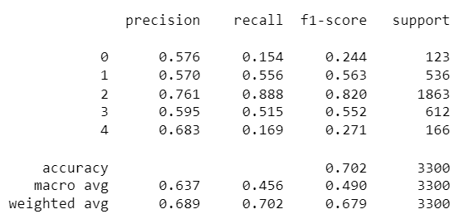
SVC: HYPERPARAMETERS

Slide 15
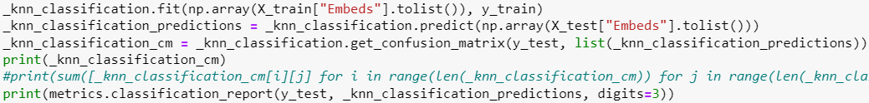
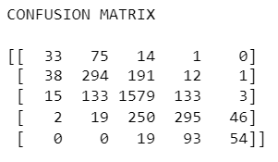
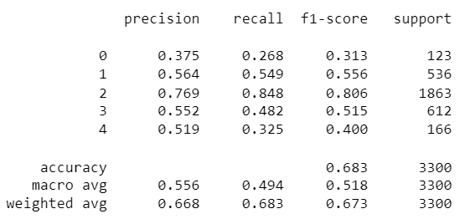
CLASSIFICATION ALGORITHMS: K NEAREST NEIGHBOUR

Slide 16
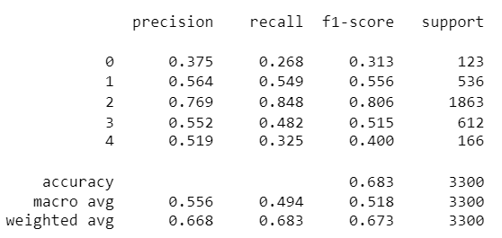
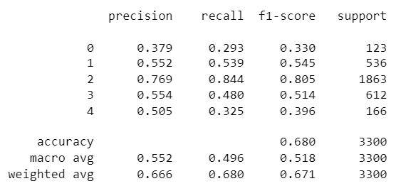
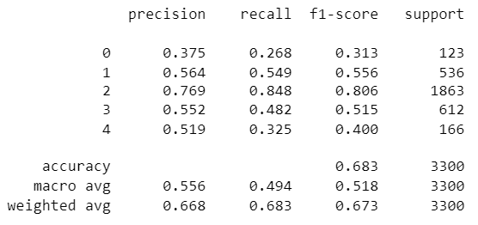

KNN: HYPERPARAMETERS

Slide 17
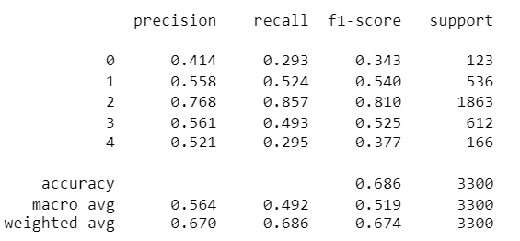
KNN: HYPERPARAMETERS

Slide 18
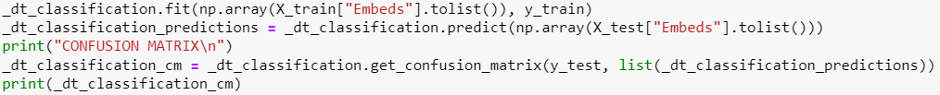
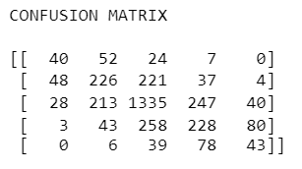
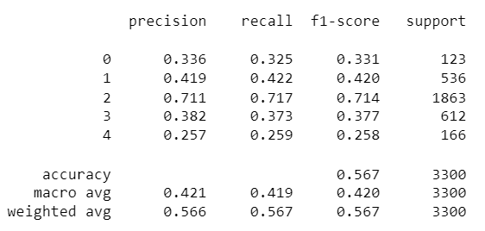
CLASSIFICATION ALGORITHMS: DECISION TREE

Slide 19
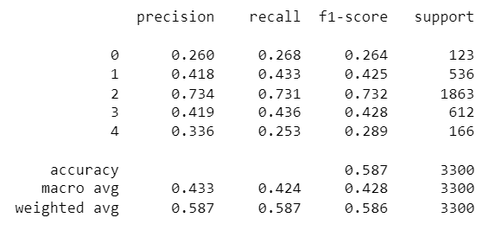
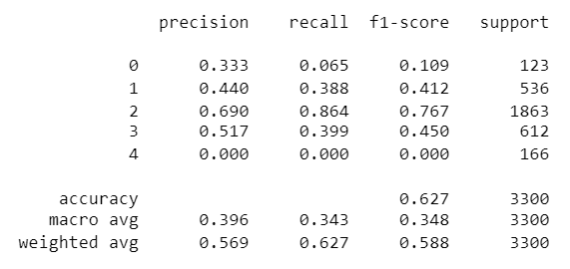
DECISION TREE: HYPERPARAMETERS

Slide 20
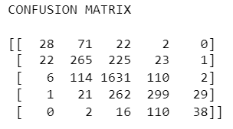
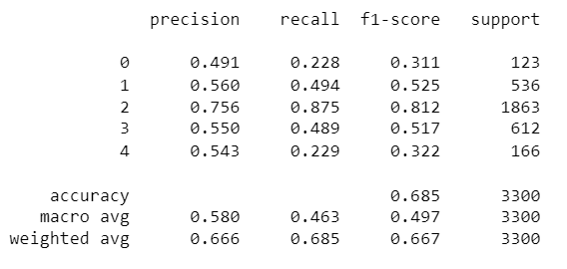
CLASSIFICATION ALGORITHMS: GRADIENT BOOSTED DECISION TREE

Slide 21
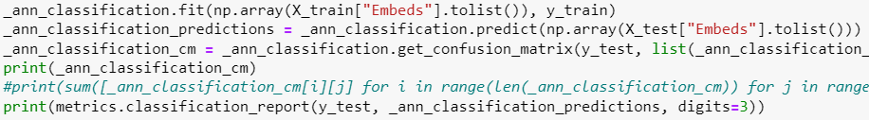
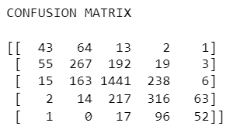
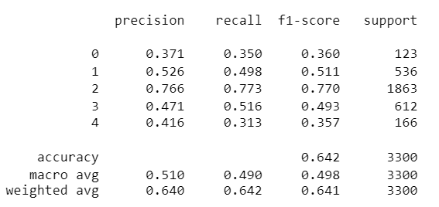
CLASSIFICATION ALGORITHMS: MULTI LAYER PERCEPTRON

Slide 22
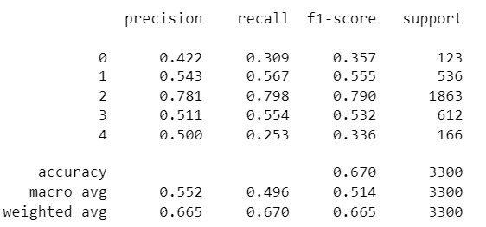
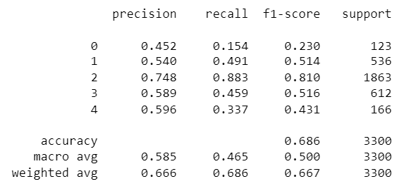
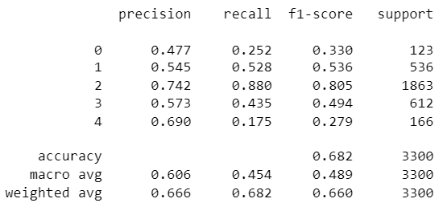
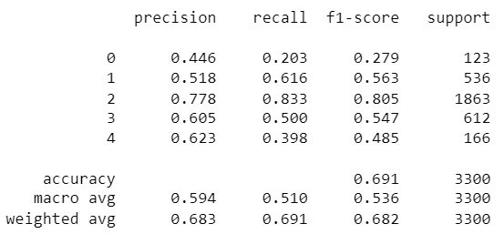
MLP: HYPERPARAMETERS

Slide 23
PERFORMANCE COMPARISON
ALGORITHM | ACCURACY (100%) | RANKING
SVC (Support Vector Classifier) | 70.2 | 1
ANN (Multi Layer Perceptron) | 69.1 | 2
KNN (K Nearest Neighbour) | 68.6 | 3
Gradient Boosted Decision Tree | 68.5 | 4
Logistic Regression | 68.2 | 5
Decision Tree | 62.7 | 6
Naïve Bayes | 54.2 | 7

Slide 24
SUMMARY
The data was not empty and had well segmented sentences into phrases. For this example we used the BERT model for finding text embeddings.
SVC performed better on average for different sets of parameters.
SVC gave the maximum accuracy on the 10000 subset of the complete data.
Decision Tree did not perform well over the word embeddings with various parameters.
Naïve Bayes performed the worst out of all the models.
Logistic Regression, KNN and GBDT gave almost same metrics while tuning the hyperparameters.

